Slide 1
4 Corners

Slide 2
Corner 1
The _________ is better in America.
Corner 2
The _________ is worse in America.
Corner 3
The _________ is about the same as in America.
Corner 4
The _________ is the BEST in my country!

Slide 3

Education

Slide 4
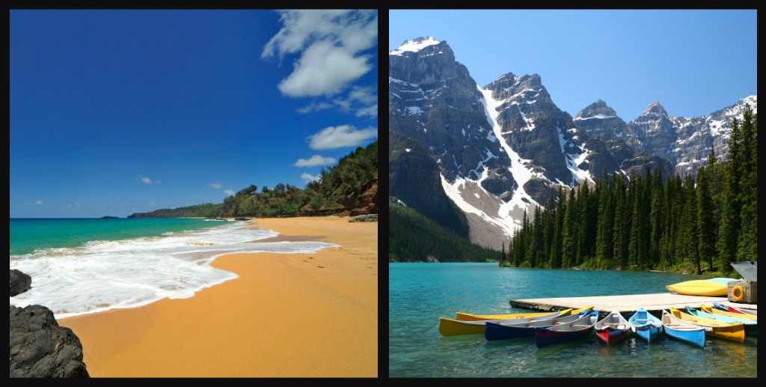
Landscape / Weather / Natural Beauty

Slide 5

Work / Employment

Slide 6
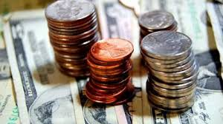
Money / Banking

Slide 7

Discrimination

Slide 8

Healthcare

Slide 9
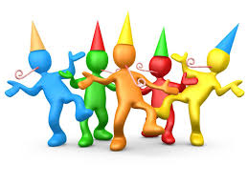
Celebrations / Holidays

Slide 10

Music / Dancing

Slide 11
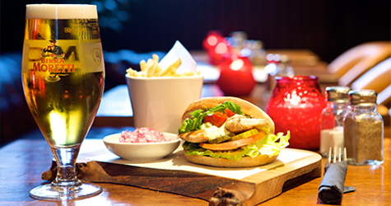
Food / Drink

