Slide 1
PARTNER NAMES HERE
EL Civics Objective 11.5
Fall 2015

Slide 2
Student 1 name and country

Slide 3
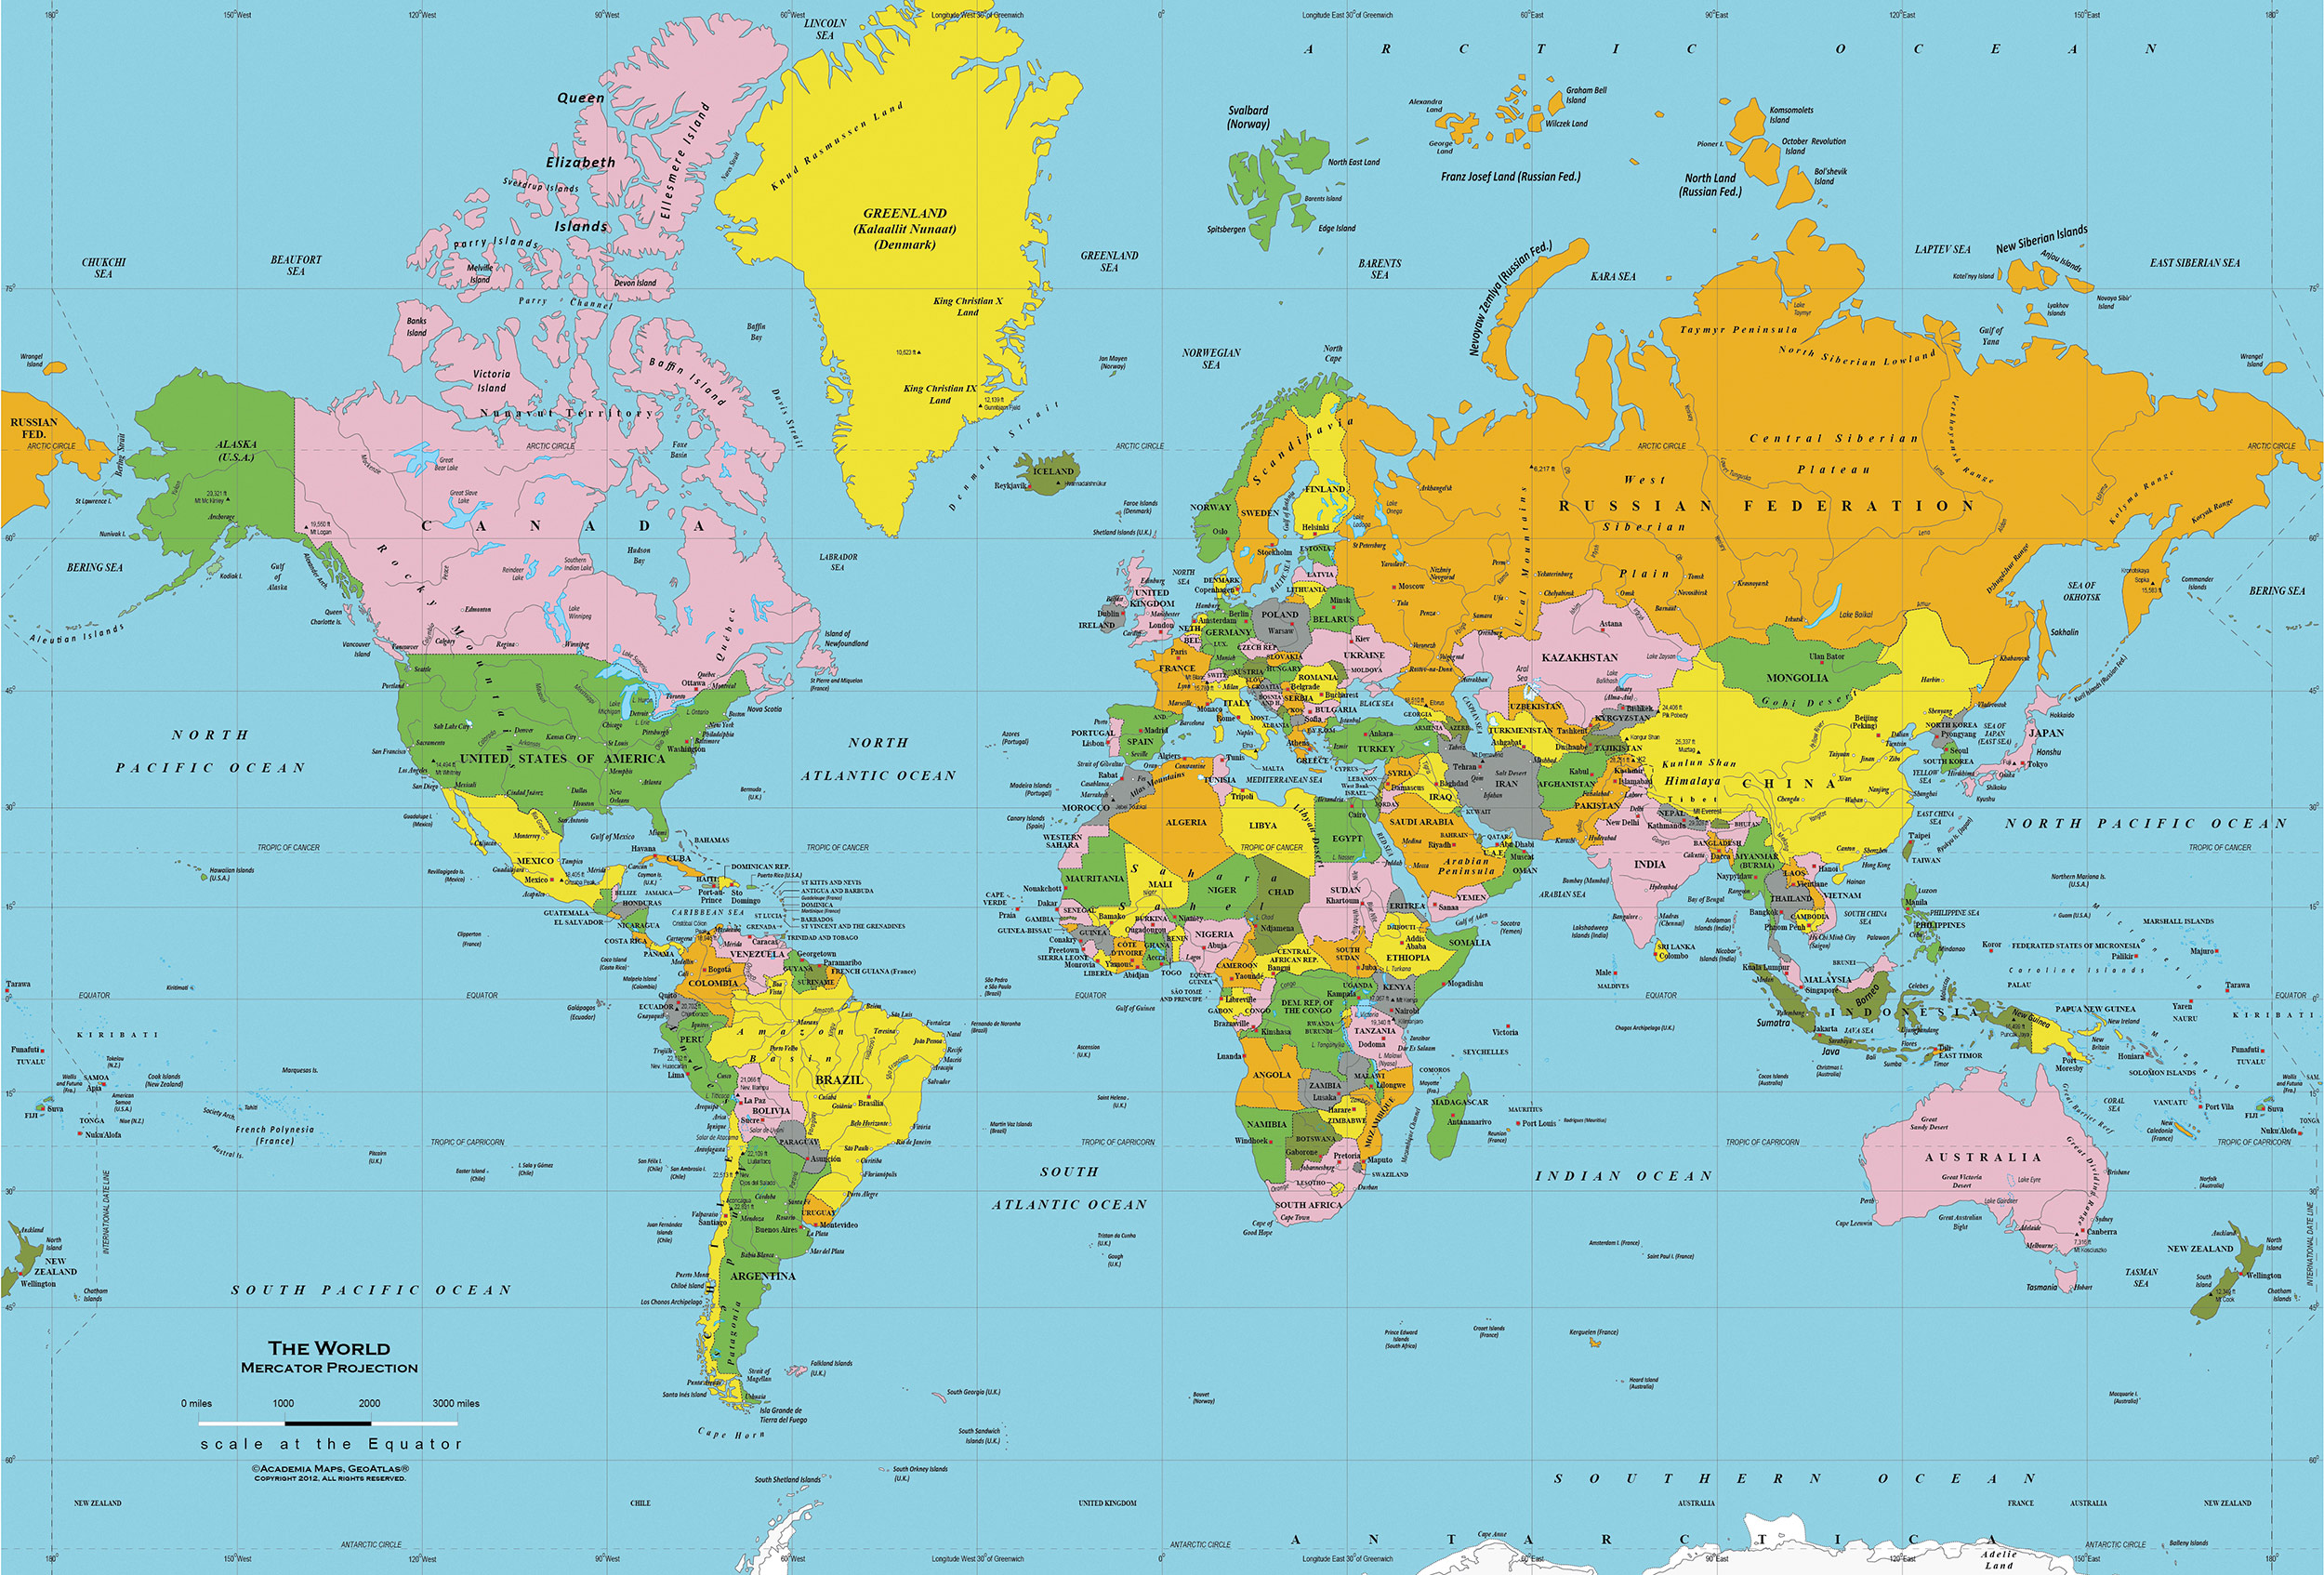

Slide 4
Student 1 – home country

Slide 5
Student 1 - school

Slide 6
Student 1 – free time

Slide 7
Student 1 – favorite holiday

Slide 8
Student 2 – name and country

Slide 10
Student 2 – home country

Slide 11
Student 2 - school

Slide 12
Student 2 – free time

Slide 13
Student 2 – favorite holiday

