Slide 1
Tenses
V2A

Slide 2
Present Simple
Present Simple:
When sth is a fact/true
Habits
Things that happen regularly (regelmatig)
Keywords: usually, often, sometimes, always, never, every week/year/day/month, on Mondays, daily, etc.
Example sentences:
Jimmy usually has football practice on Tuesdays.
Peter and Amy like horror films.

Slide 3
Present Simple
Present Simple:
HOW?
Infinitive
Shit: +s
Do/don’t
Shit: does/ doesn’t
DO/DON’T/ DOES/DOESN’T followed by: infinitive
+ | ? | -
I work | Do I work? | I don’t work
You work | Do you work? | You don’t work
He works | Does he work? | He doesn’t work
She works | Does she work? | She doesn’t work
It works | Does it work? | It doesn’t work
We work | Do we work? | We don’t work
You work | Do you work? | You don’t work
They work | Do they work? | They don’t work

Slide 4
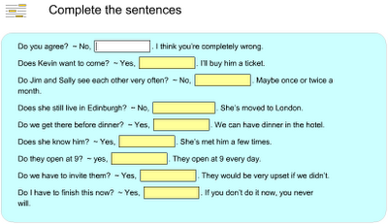
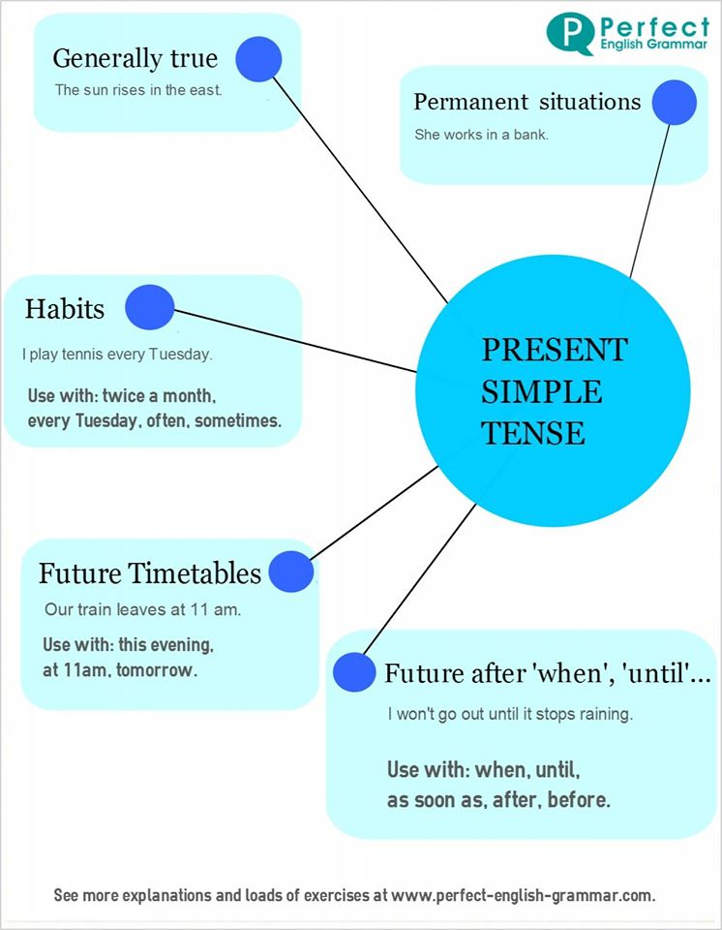
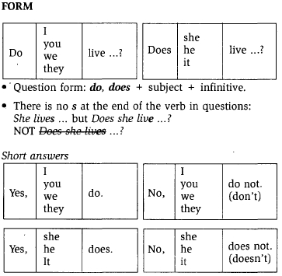

Slide 5
Present Continuous
Present Continuous:
When sth is happening right now/at this moment
Arrangement in the future
Something that is only temporary
A change that takes place over a period of time
Keywords: right now, at the moment, look!
Example sentence:
She is doing a project this term.

Slide 6
Present Continuous
Present Continuous:
HOW?
Am/are/is + verb + ing
+ | ? | -
I am working | Am I working? | I’m not working
You are working | Are you working? | You aren’t working
He is working | Is he working? | He isn’t working
She is working | Is she working? | She isn’t working
It is working | Is it working? | It isn’t working
We are working | Are we working? | We aren’t working
You are working | Are you working? | You aren’t working
They are working | Are they working? | They aren’t working

Slide 7
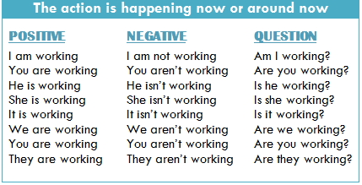
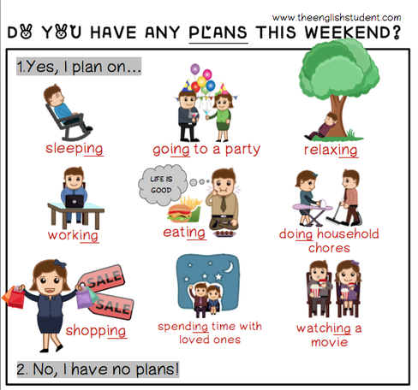

Slide 8
Past SIMPLE
Past Simple:
When sth happened at a particular/specific moment in the past.
Multiple actions that took place one after another in the past.
Sth that ended in the past.
Keywords: in 1967, yesterday, ...ago, last night/week/year /month, and when.
Example sentences:
He worked in a factory in 1834 I wrote this letter when I was 16.

Slide 9
PAST SIMPLE
Past Simple:
HOW?
Verb+ed/ 2nd column
Did/didn’t
DID/DIDN’T folowed by: infinitive
+ | ? | -
I worked | Did I work? | I didn’t work
You worked | Did you work? | You didn’t work
He worked | Did he work? | He didn’t work
She worked | Did she work? | She didn’t work
It worked | Did it work? | It didn’t work
We worked | Did we work? | We didn’t work
You worked | Did you work? | You didn’t work
They worked | Did they work? | They didn’t work

Slide 10
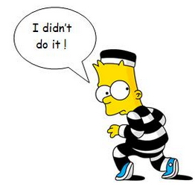

Slide 11
Past Continous
Past Continuous:
When an action went on for some time in the past.
When an action was taking place in the past and another interrupted it.
Keywords: while
and other past time expressions: yesterday, ...ago, last night/week/etc.
Example sentence: We were having dinner last night, when the phone rang.

Slide 12
PAST CONTINUOUS
Past Continuous:
HOW?
Was/were + verb + ing
+ | ? | -
I was working | Was I working? | I wasn’t working
You were working | Were you working? | You weren’t working
He was working | Was he working? | He wasn’t working
She was working | Was she working? | She wasn’t working
It was working | Was it working? | It wasn’t working
We were working | Were we working? | We weren’t working
You were working | Were you working? | You weren’t working
They were working | Were they working? | They weren’t working

Slide 13
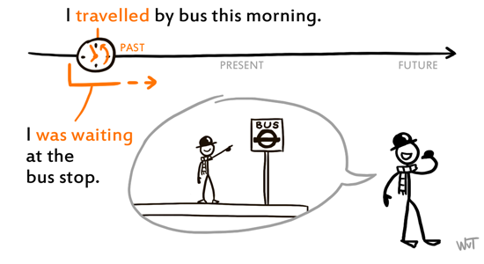

Slide 14
Present Perfect
When sth started in the past and is still happening/true right now.
Events/experiences that have happened in the past. (NO SPECIFIC MOMENT IS MENTIONED)
When sth happened in the past and is finished, but still has an effect/result in the present.
Keywords: for, yet, never, ever, just, already, since, always
Example sentence: I have never seen this film before! She has lived in Eindhoven since she was 10.

Slide 15
Present perfect
Present Perfect:
HOW?
Have/has + p.p.
(past participle)
Past participle: verb+ed or 3rd column
+ | ? | -
I have worked | Have I worked? | I haven’t worked
You have worked | Have you worked? | You haven’t worked
He has worked | Has he worked? | He hasn’t worked
She has worked | Has she worked? | She hasn’t worked
It has worked | Has it worked? | It hasn’t worked
We have worked | Have we worked? | We haven’t worked
You have worked | Have you worked? | You haven’t worked
They have worked | Have they worked? | They haven’t worked

Slide 16
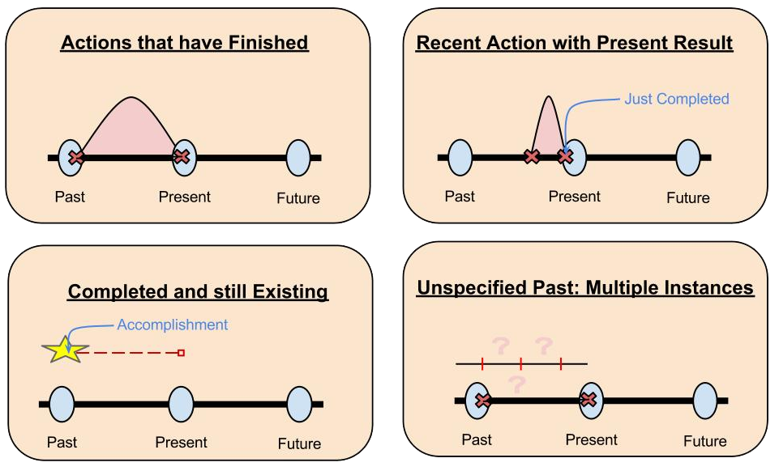

Slide 17
Future forms
There are three verb forms that you can use to talk about the future:
Will + infinitive
‘Be’ going to + infinitive
Present Continuous
→ We use WILL to talk about a PREDICTION for the future.
→ We use GOING TO to talk about an INTENTION for the future.
→ We use PRESENT CONT. to talk about an ARRANGEMENT in the future

Slide 18
FUTURE FORMS
WILL | BE GOING TO | PRESENT CONTINUOUS
I will work | I am going to work | I am working
You will work | You are going to work | You are working
He will work | He is going to work | He is working
She will work | She is going to work | She is working
It will work | It is going to work | It is working
We will work | We are going to work | We are working
You will work | You are going to work | You are working
They will work | They are going to work | They are working
- | - | -
I won’t work | I’m not going to work | I’m not working
? | ? | ?
Will I work? | Am I going to work? | Am I working?

Slide 19
