Slide 1
Describing People
Week 2: June 7th – June 9th, 2016

Slide 2
What is the difference between these questions?
What would you like?
What do you like?
What is he/she like?
What does he/she look like?
(desire)
(-to do, -to have)
(personality)
(appearance)

Slide 3
Physical Appearance

Slide 4
Use –to be verb to describe height and body build
Examples:
I am tall and slim.
He is fat.
Ann is short.
You are thin.
They are tall.

Slide 5
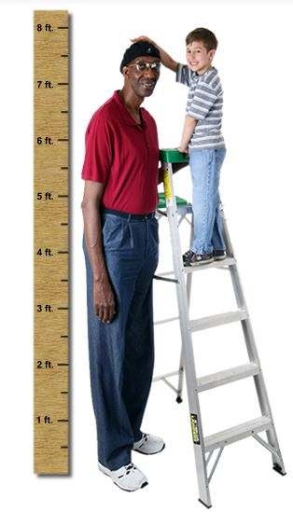
Complete the sentences with a partner.
I ______ short.
Kate ______ a small girl.
Tom _______ very fat.
Why _______ you so thin?
He _______ very tall.

Slide 6
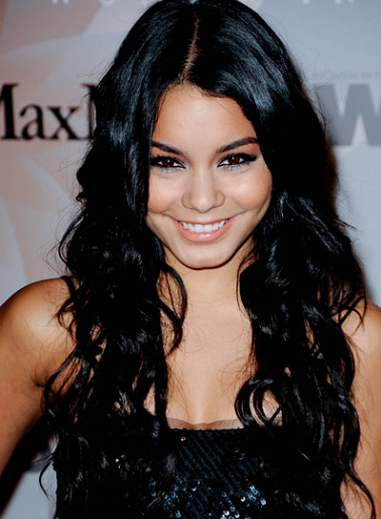
Use –to have to describe hair color AND length, facial features, AND OTHER FEATURES
Examples:
Jack has short hair.
I have long black hair.
She has blue eyes.
My teacher has a round face.
He has a long nose.

Slide 7
Describing the face

Slide 8
Describe these people to a partner.

Slide 11
Describing Personality and character Traits

Slide 12
Objective: describe yourself, a boss, a neighbor, spouse, friend, or other family member
For example:
I really like my best friend. She is talkative, compassionate, and friendly. She cares about me and my family. If I am feeling sad or upset, she will cheer me up with a phone call or suggest we watch a movie.
However, I once had a friend who was very disrespectful and very self-centered. We got into a huge fight about something, and now we are no longer friends.

Slide 13
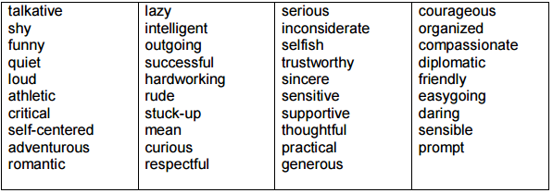
Which are positive? Which are negative? Which are neutral?
We usually use these adjectives with the – to be verb
Example: She is outgoing, funny, and successful.

Slide 14
Choose one, two, or three with different meanings to describe a person.
Don’t forget to use commas if you are listing more than 2 adjectives.
You can use both physical and personality adjectives together in one sentence, especially when describing people you know well.
Example: He is handsome, athletic, and sincere.

Slide 15
Verbs and adjectives to describe feelings
A verb directly express your feelings about a person.
Ex: I _________ her.
Ex: I _________ him.

Slide 16
How to describe feelings

Slide 17
Or you can use an adjective to describe how you feel, or how another person makes you feel at a particular time
Ex: I am _________. I feel ___________.
She is ___________. He is ___________.
He makes me feel ___________. He makes her feel ___________.
She makes me feel ____________. She makes him feel _______.

Slide 18
When we aren’t sure about how another person feels, we can use “seems to be” or “appears to be” with an adjective
Example: She appears to be confused. He seems to be bored.

Slide 19
The best and worst person
With a partner, come up with a description of the best and worst person in each category. Add an emotional component to your description. How does he or she make you feel?
Example: My best friend is sincere, sensitive, and trustworthy. She makes me feel relaxed.
A. What is the best ……
spouse like?
neighbor like?
friend like?
you like?
Why? How do they make you feel?
B. What is the worst ……
spouse like?
neighbor like?
friend like?
you like?
Why? How do they make you feel?

Slide 20
C. Describe one person you really know and like. Who is it? What are some things you like about him or her? How does he or she make you feel?
D. Describe one person you really know and don’t like. Who is it? What are some of the reasons you don’t like him or her? How does he or she make you feel?

Slide 21
Emotions

Slide 22
Emotion idioms

Slide 23
Choose the Correct idiom.
A: Hey! Why don’t you clean up? B: I’ll do it tomorrow….. a – I don’t feel like it now b – I’m over the moon c – I’m cheesed off
I’ve failed my driving test for the third time…. a – I’m over the moon b – I’m down in the dumps c – I don’t really feel like it no
He’s got a date tonight….. a – He’s over the moon about it b – He’s really cheesed off about it c – He’s really down in the dumps
Someone stole her new jacket …. a – She’s over the moon about it b – She couldn’t be bothered c – She’s really cheesed off about it
5) I should do the shopping today, but …… a- I’ m over the moon b – I just couldn’t be bothered c – I’m cheesed off
6) He’s had a lot of bad luck recently. That’s why …. a – he’s so down in the dumps b – he couldn’t be bothered c – he’s over the moon
7) A: What would you like for lunch? B: ------ a – I just couldn’t be bothered b – I feel like sausage, eggs, and hash browns c – I’m cheesed off
8) Watch out for the boss today. … a – It’s not worth it b – She couldn’t be bothered c – She’s really cheesed off about something

Slide 24
Word study Suffix: -ful
Add –ful to the end of some nouns to make an adjective
Example: stress + ful = stressful Too much stress is not good for you. My job is stressful.
stress stressful beauty _________
care careful _______ colorful _____ thankful
Our new neighborhood park is __________________. (beauty)
The park’s trees are very ______________ right now. (color)
A walk in the park makes life less ___________________. (stress)
The park is very _____________ for bringing families together. (help)

Slide 25
Comparatives and superlatives
Comparatives (more)
Superlatives (most / least)
use when comparing two items or things
add –er to express superiority
use “than” to compare two things in a sentence
use to show which is greatest within a set group
add –est to express superiority

Slide 26
Comparatives and superlatives
Notes | Superlative |  | Adjective | Comparative | Notes
Add -est |  | one syllable | small high fast |  | Add –er or –r (watch out for VCV)
Change y to i and add -er |  | ending in -y | funny sunny |  | Change y to i and add -er
Put most in front of the adjective |  | two or more syllables | expensive beautiful |  | Put more in front of the adjective
-- |  | irregular forms | good bad |  | ---

Slide 27
Write the Comparative and superlative forms.
Word Comparative Superlative
1) hot
2) nice
3) sunny
4) expensive
5) bad
6) good
7) organized
8) patient
9) thin
10) angry

Slide 28
Practice Time!
Al doesn’t work quickly or carefully. He’s the ____________ worker I know. (efficient)
Paulo is nice to everyone. He’s the _______________ person I know. (kind)
Sara is organized, but Tom is not. Sara is _____________ than Tom. (organized)
Lee isn’t friendly. He’s the _______________ person I know. (friendly)
Tim helps a lot of people, and Kim helps less people. Tim is __________ than Kim. (helpful)
Don is very happy. He’s the ______________ person I know. (happy)
Rosa never gets angry. She’s the _______________ I know. (patient)
Frank is a very sweet person, and John is very mean. John is _______ than Frank.

