Slide 1
Work Presentation
By Miss Michelle Bañez

Slide 2
Accounts Payable – Toyota of Temecula Valley
1) Miss Michelle Bañez

Slide 3
Accounts Payable - Toyota
Accounts Payable –
Paid all of the bills for the company
Paid all vendors for services
Kept accurate records of the budget
I worked there for 3 years. From 2012-2015
I worked in several positions there:
Receptionist
Cashier
Appointments
Reconditioning Administrator
Accounts Payable

Slide 4
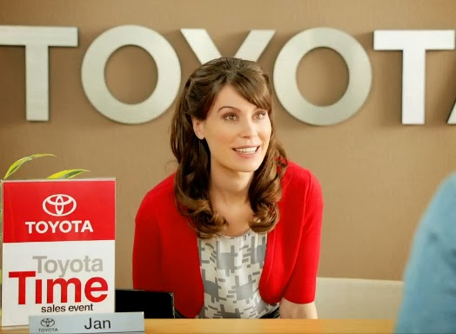
Accts. Payable – Toyota
I liked the people that I worked with.
I had a lot of fun working there and learning different things about cars and maintenance.
I did not like the uniform or the clothes we had to wear! (I love to wear my dresses and high heels!)
I also worked at Starbucks for many years!
I have worked a total of 33 jobs.
I have volunteered at MSJC as an ESL tutor.

Slide 5
Skills – Miss Michelle
From working, I learned that I need to be responsible with money and time.
It is important to keep track of money, and pay the bills on time!

Slide 6
Thank you!
This is the end of Miss Michelle’s presentation.

