Slide 1
PARTNER NAMES HERE
EL Civics Objective 11.5
Fall 2015

Slide 2
Student 1 name and country

Slide 3
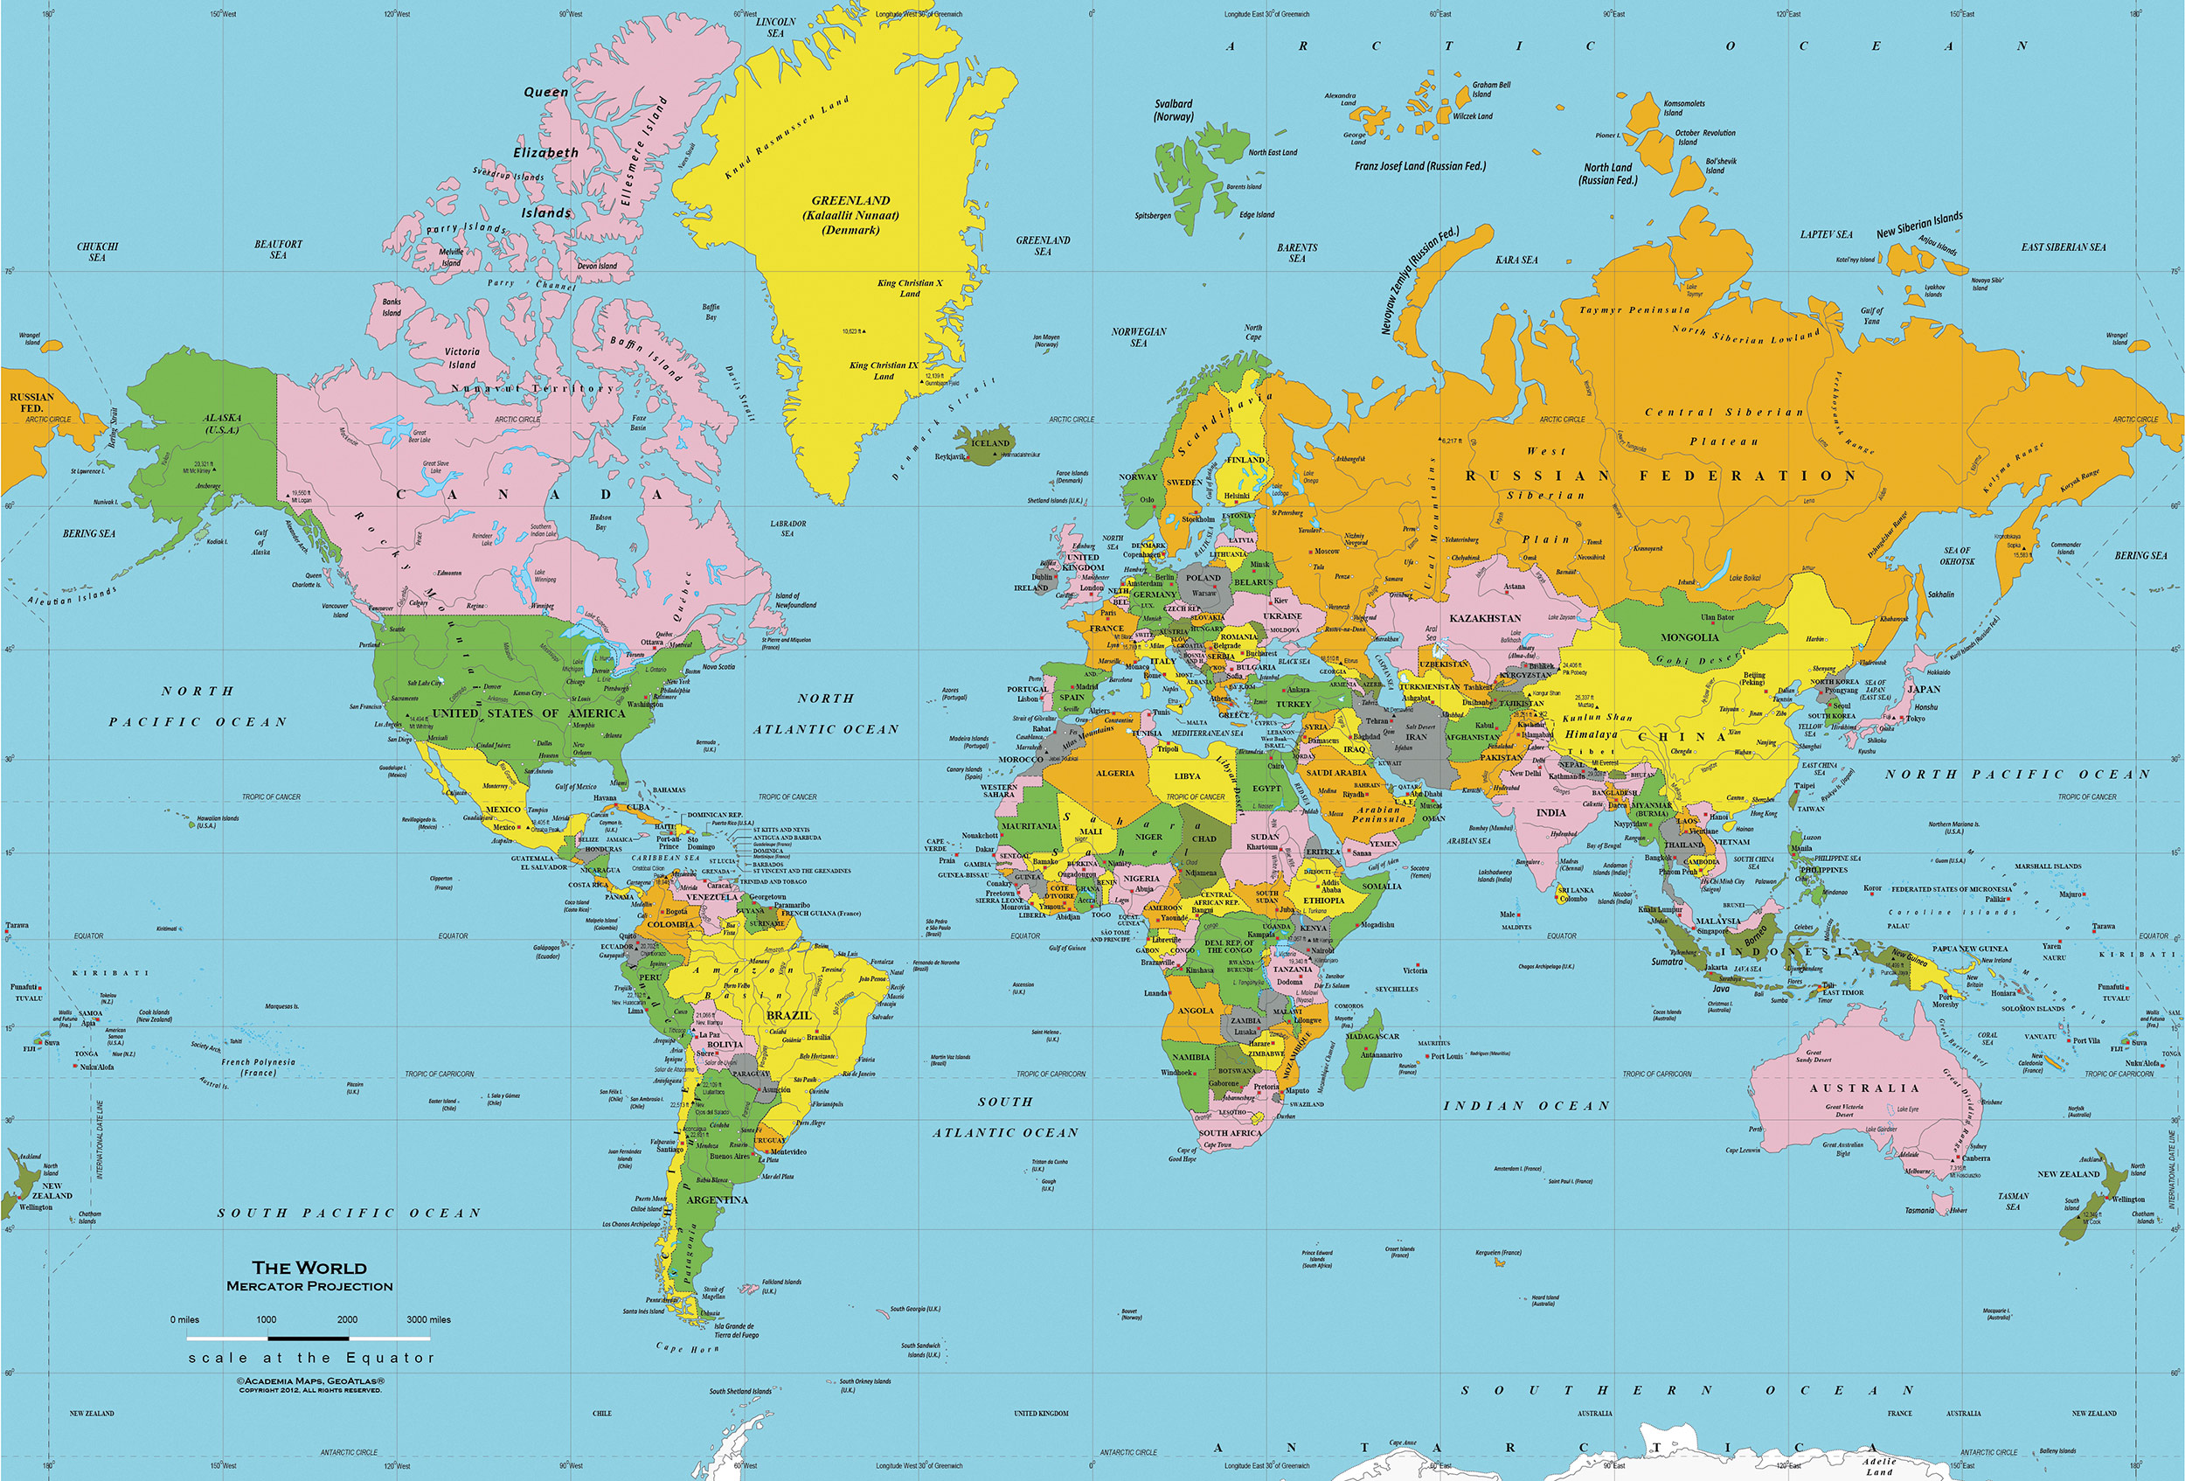

Slide 4
Student 1 - holiday

Slide 5
Student 1 - school

Slide 6
Student 1 - government

Slide 7
Student 1 – resolve family problem

Slide 8
Student 1 – free time

Slide 9
Student 2 – name and country

Slide 11
Student 2 - holiday

Slide 12
Student 2 - school

Slide 13
Student 2 - government

Slide 14
Student 2 – resolve family problem

Slide 15
Student 2 – free time

