Slide 1
S.M.A.R.T. GOAL PLANNER MAP
Specific > Measurable > Attainable > Reasonable > Time-Bound FALL 2017

Slide 2
S.M.A.R.T. GOALS

Slide 3
S.M.A.R.T. GOALS
GOAL (n.) /goʊl/ Synonyms: target; purpose, object, objective, intent, intention 1. The result or achievement toward which effort is directed; aim; end. 2. the terminal point of a journey or race
DEFINITION
ACCOMPLISH (ED) (v) /əˈkɒmplɪʃt/ Synonyms: achieve, attain, realize, get, do, execute, manage, finish, conclude, reach or complete successfully

Slide 4
Specific goal
Who: Who is involved? I am
What: What do I want to accomplish? Crochet a baby bear beanie
Where: Identify a location. My living room / bedroom
When: Establish a time frame. Crochet for 30 minutes every night
Why: Specific reasons, purpose or benefits of accomplishing the goal. My friend is having a baby! I want to give her a special gift.
To set a specific goal you must answer the "W" questions

Slide 5
Goal has to be …
Measurable How much? 30 minutes How many? One beanie How will I know when it is accomplished? I will crochet for 30 minutes every night until September 10th (or the baby is born)
Attainable You can attain most any goal you set when you plan your steps wisely and establish a time frame that allows you to carry out those steps.

Slide 6
Goal has to be…
REALISTIC Your goal is probably realistic if you truly believe that it can be accomplished.
Have you accomplished anything in the past?
TIME BOUND (TIMELY) Set a timeframe for the goal or next week, in three months, by the end of the year.
Putting an end point on your goal gives you a clear target to work towards.

Slide 7
How to write S.M.A.R.T. GOALS
I will read a short book in English during two months, so I can increase my vocabulary.
I will watch a TV program in English 5 days a week for 15 minutes and write one sentence about it during until December 10th. (to increase my listening comprehension)

Slide 8
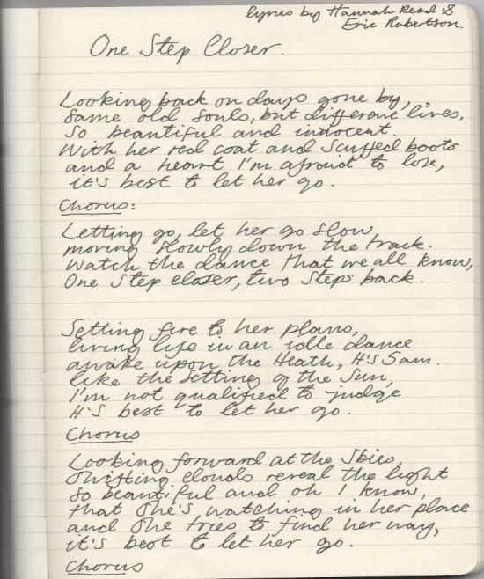
How to write S.M.A.R.T. GOALS
Twice a week, I will write 2 recipes in English in a notebook during this semester , so can understand how to follow instructions.
During this semester, I will copy 1(one) lyric of a song and sing it aloud in my house until……
[ so I can improve my fluency, listening comprehension in English] .

Slide 9
How to write S.M.A.R.T GOALS
I will place telephone calls to my friends or classmates in English to improve my communication skill; [3 times a week until Dec. 10th
I will read short articles from a newspaper to increase my comprehension skill in the next 3 months.
I will read short articles in a magazine once a week, and write one sentence about it until [Dec. 10th, 2017]
I will sing a song and copy the lyrics in my notebook once a week for 3 months, so I can increase my vocabulary and fluency in English.

Slide 10
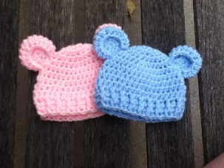
Mrs. Michelle’s Goal
HOW I am going to reach my goal ?
GOAL
I will crochet a baby beanie for 30 minutes a night so I can give it as a gift to my friend .
1. Buy a crochet hook and two skeins of yarn/ yarn balls
2. Find and follow a crochet pattern
3. Crochet the beanie for 30 minutes every night

Slide 11
Mrs. Michelle’s Goal
SOURCE OF MOTIVATION
What is going to motivate me to accomplish my goal?
My friend is having a baby! I want to give her something very special, and show her that I care.
When will I meet this goal?
I will meet my goal on September 10th, 2017.

Slide 12
Time for questions & comments !

